Slide 1





EDUCATION SYSTEM OF PAKISTAN
DONE BY: MEHAK RANI

Slide 2

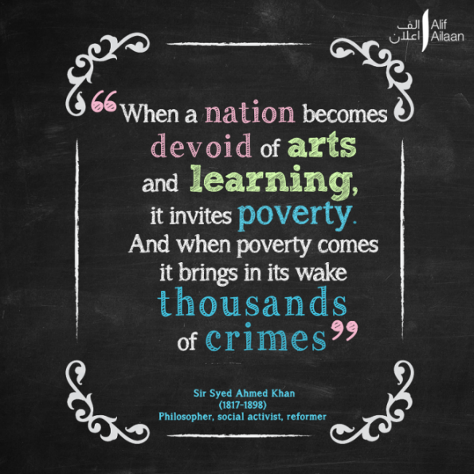
Education AND ITS IMPORTANCE
Education is basic human right that must be achieved by all. It helps to develop the skills that are needed for the progress and prosperity of the country.
The importance of education can not be neglected in any case. High literacy rate ensures sustainable economic development, labor productivity and economic prosperity.
Sir Syed Ahmed Khan said:
“ When a nation becomes devoid of arts and learning it invites poverty, and when poverty comes it brings in thousands of crimes”

Slide 3

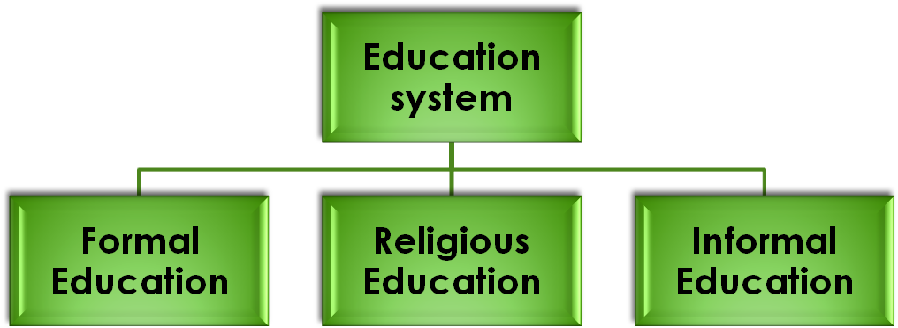
EDUCATION SYSTEM OF PAKISTAN
Education in Pakistan is overseen by the Federal Ministry of Education and the provincial governments.
English and Urdu are the primary Languages in education system of Pakistan.
It is generally divided into six levels:
Preschool (for the age from 3 to 5 years)
Primary (Class one to five)
Middle (Class six to eight)
Secondary/Matriculation (Class nine and ten, leading to the Secondary School Certificate or SSC)
Higher secondary/Intermediate (Class eleven and twelve, leading to a Higher Secondary School Certificate or HSSC)
University programs leading to undergraduate and graduate degree

Slide 4
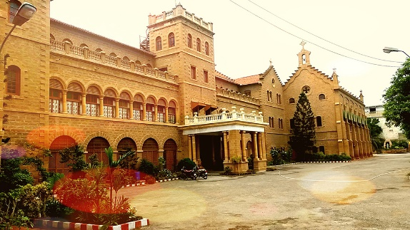
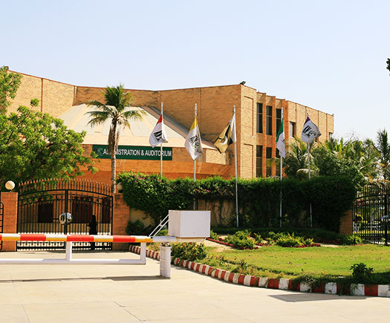
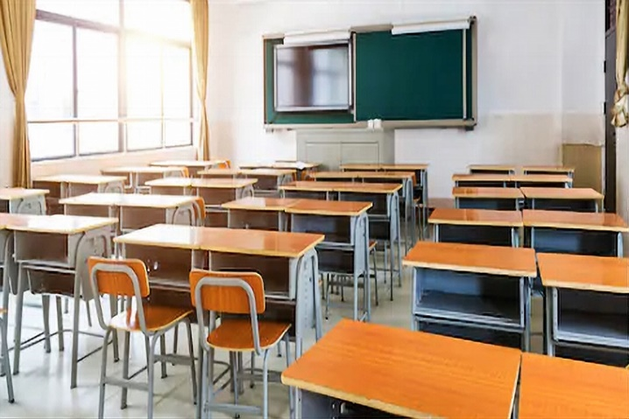
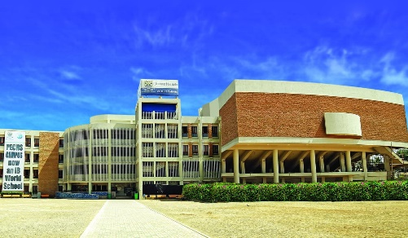
Types of schools in Pakistan
Private schools
Government schools
O/A Levels schools
NGO based schools
Madrasa

Slide 5

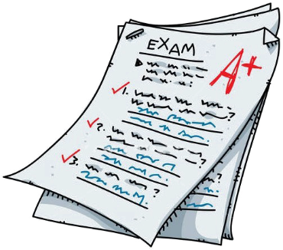
The standard of education in Pakistan
Educational standard is defined by the knowledge and skill students possess.
The educational standard of Pakistan is declining day by day:
It mostly contains theory and no practical knowledge is given to the students.
The ranking and grades of students is given more importance than their skills.
Examination pressure is kept on the students without any proper knowledge.
Heavy fees is charged but no skill is provided to students .

Slide 6

Causes for the downfall education standard
There are many reasons for the downfall of educational standard few of them are:
Lack of funds, lack of resourceful and trained trainers and administers
Non-availability of professional teachers
Students are evaluated on the basis of annual exams
Poor supervision standards are used
There are no proper Libraries with physical space for Students to Study
Lack of basic resources

Slide 7


remedies for the improvement of education system
Practical knowledge should be given priority.
Activities should be arranged in schools for the students to get more skills.
Proper and trained faculty must be arranged in schools
A proper budget should be fix for the education sector.
Needed resources should be provided.
Prior knowledge
Proper resources
Budget
Activities
Proper faculty

Slide 8


